Slide 1
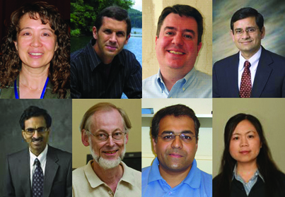
DRINET Project Overview
Carol Song
Daniel Aliaga
Jake Carlson
Indrajeet Chaubey
Rao Govindaraju
Chris Hoffmann
Dev Niyogi
Lan Zhao
Purdue University

Slide 2
Overview
Developing Community-based DRought Information Network Protocols and Tools for Multidisciplinary Regional Scale Applications (DRInet)
NSF funded Data Interoperability project
Started in Jan. 2009
Multidisciplinary team
  Carol Song (Rosen Center for Advanced Computing)
  Daniel Aliaga (Computer Science)
  Jake Carlson (Library)
  Indrajeet Chaubey (Agricultural and Biological Engineering)
  Rao Govindaraju (Civil Engineering)
  Chris Hoffmann (Computer Science)
  Dev Niyogi (Agronomy & Earth and Atmospheric Sciences)
  Lan Zhao (Rosen Center for Advanced Computing)

Slide 3
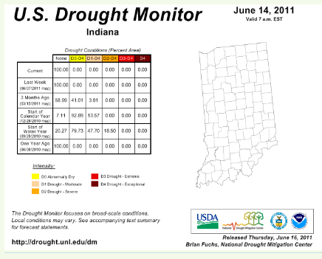
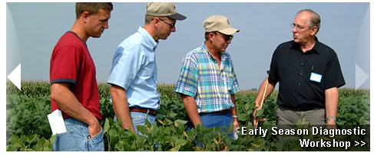

Existing Tools & Systems
Indiana: Policy for drought declaration based on Palmer index
Groups of crops and weather people we were already working with

Slide 4
Our Goals
Implement and explore computational infrastructure to create a science base for drought information collection, fusion of heterogeneous data relevant to droughts, and for facilitating the broadest possible participation of the community.
Science questions to be addressed include:
Do drought conditions currently exist, or are they imminent in my area of interest?
What kind of a drought is this likely to be (is it analogous to a previous period)?
What are the potential impacts?
What are my options for coping with this condition?
What additional data beyond the traditional hydroclimatic datasets can provide information on drought onset and impacts?
These questions will be addressed both from the collection point of view as well as from the view of the multiplicity of consumer interest in the information.

Slide 5
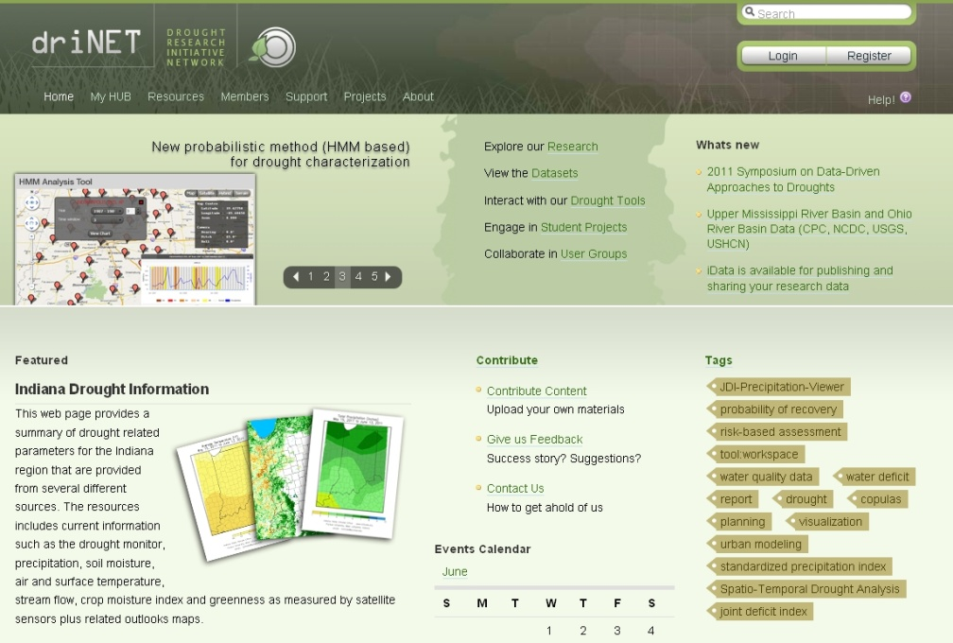
Cyberinfrastructure
DRINET CI based on HUBzero for
  Online interactive tools
  Sharing and user participation
  One stop shop for researchers, students and end users
Expanded capabilities
  Distributed data access
  Self data and metadata publishing
  Map-based navigation
  Geospatial data enabled
  Connecting data with tools, models, visualization

Slide 6
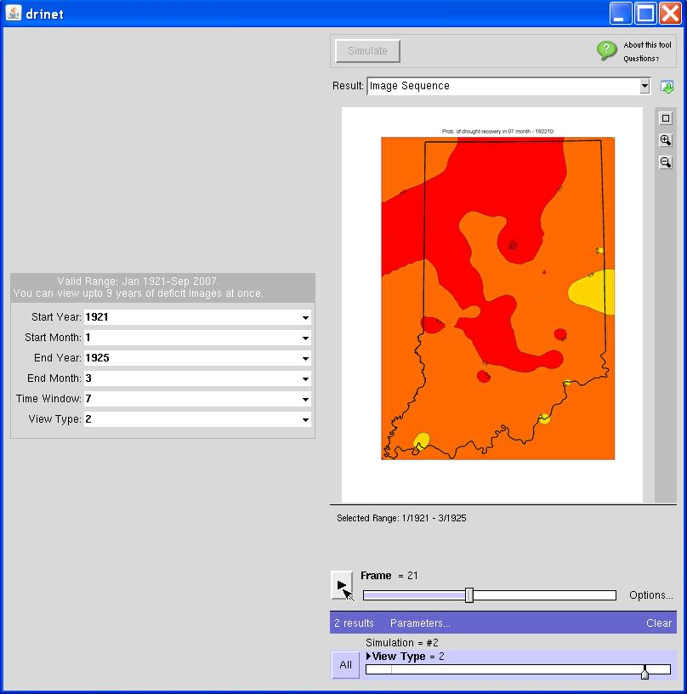
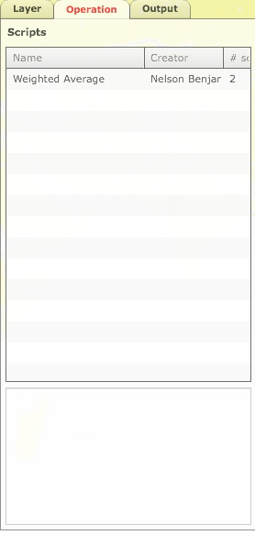
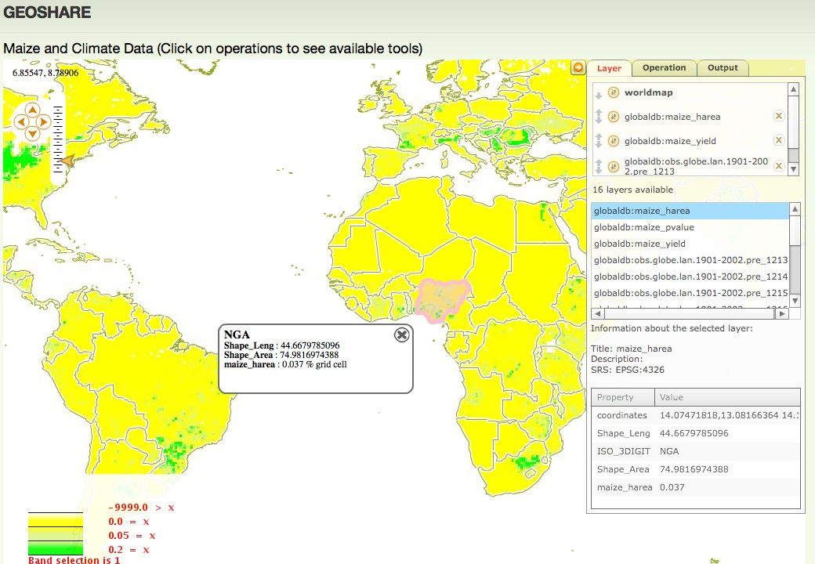
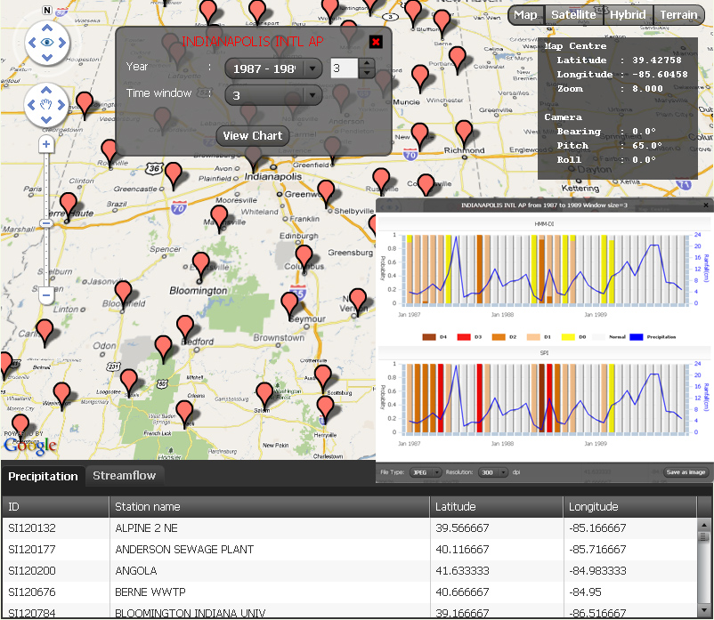
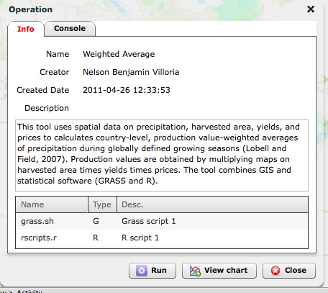
Interactive Tools
HMM-based Probabilistic Drought Classification
Apps available for this data
Water deficit viewer
6
GRASS and R tools
Notes:
HMM-based probabilistic drought classification
GIS enabled data and tool, online editing and execution
Water deficit viewer (Rappture) – visualize the precipitation needed in order to recover from an existing drought and probability of recovery during a specific time window

Slide 7
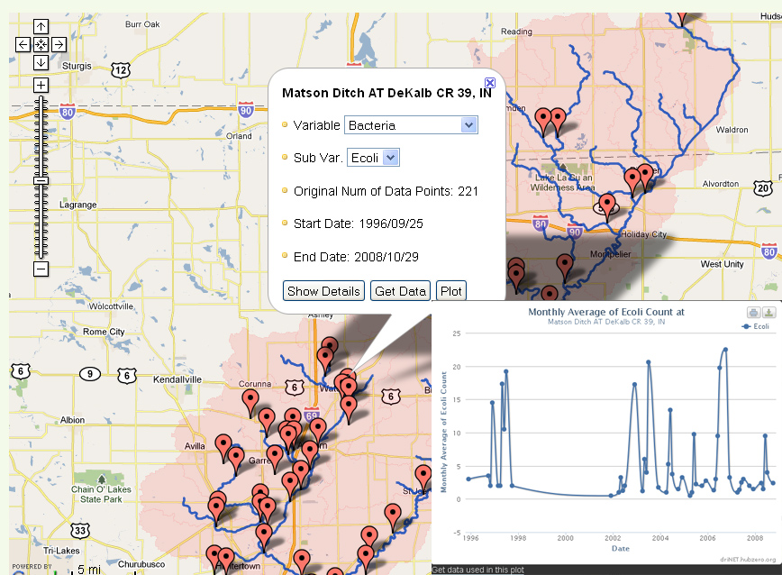
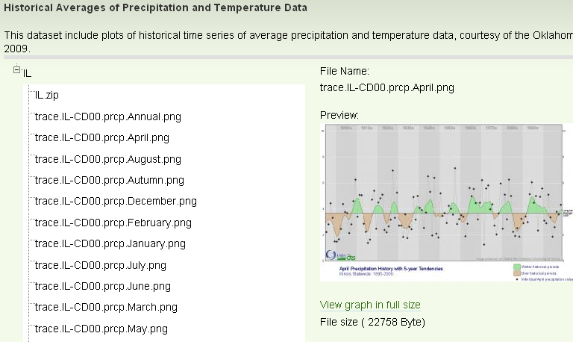
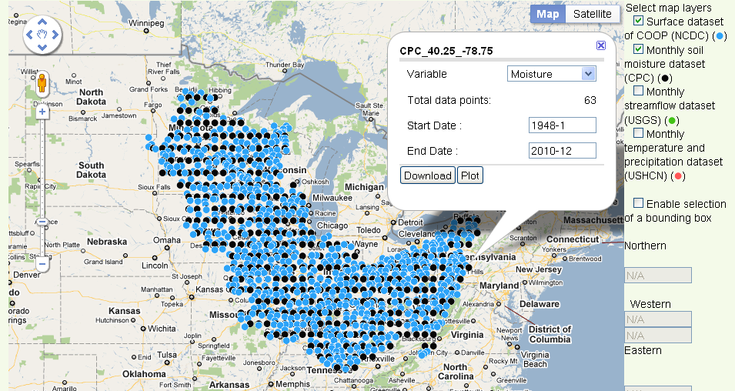
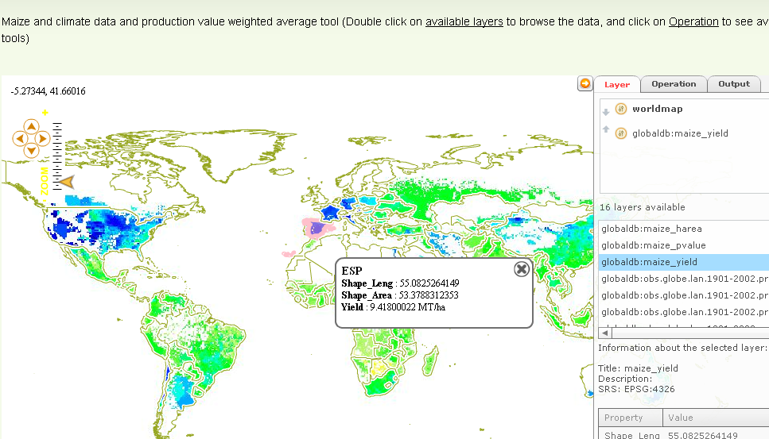
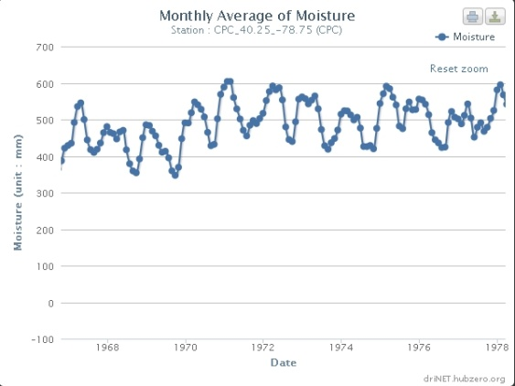
Data
Water quality data
Global maize yield data
Upper Mississippi River Basin and Ohio River Basin Data

Slide 8
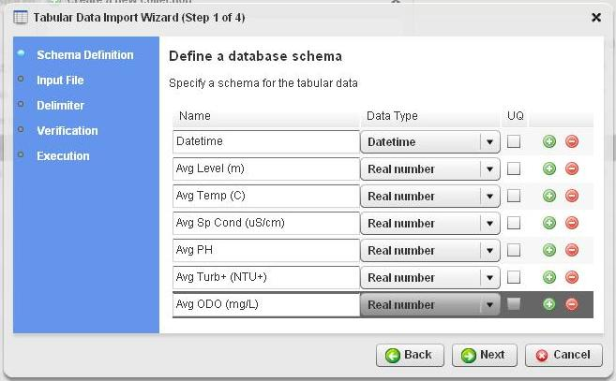
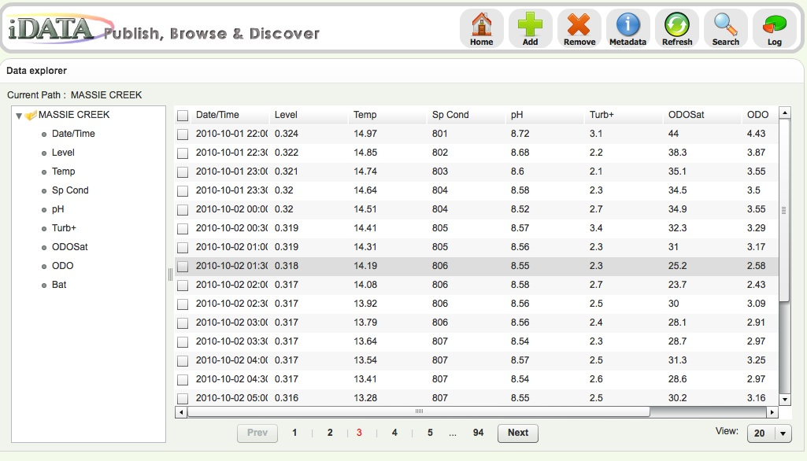
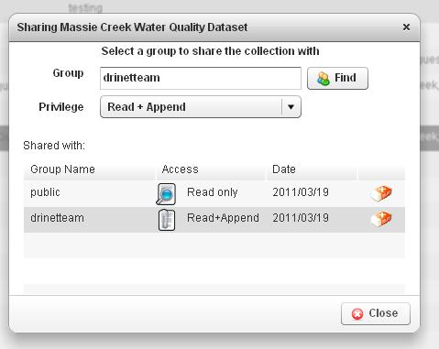
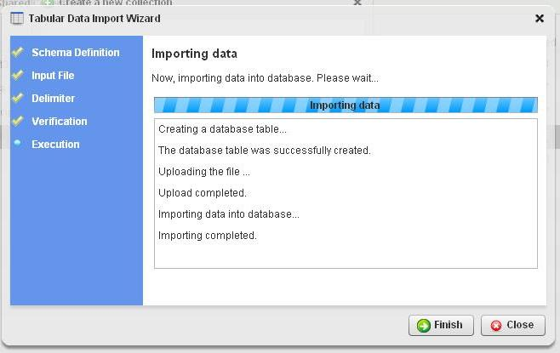
Data Publishing

Slide 9
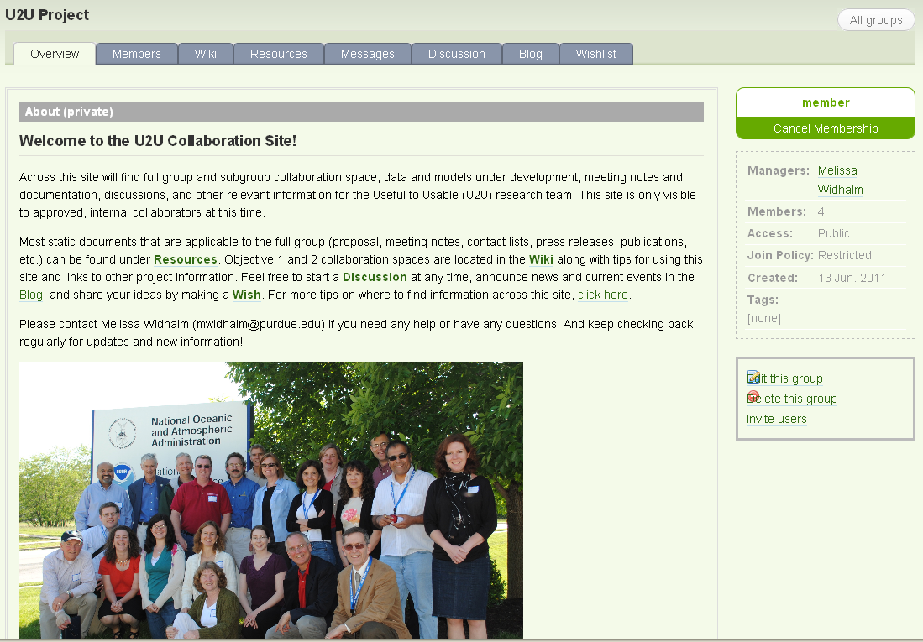

Collaboration

Slide 10
Metadata for DRINET
Jake Carlson

Slide 11
Metadata for DRINET
Functionality:
  Discovery
  Description
  Defining Relationships
  Dissemination
Challenges:
  Diversity of Data
  Diversity of Audience & Needs
  Need for a Balance – depth & breadth; standards & local needs

Slide 12
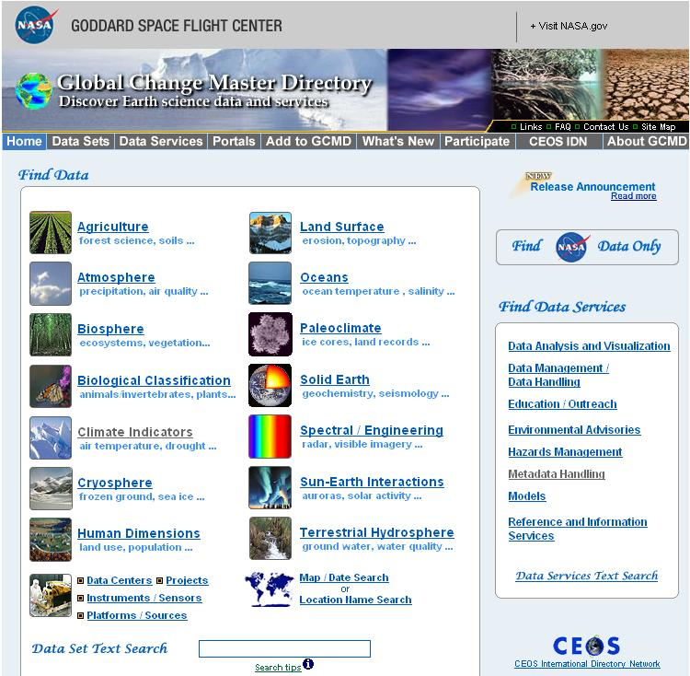
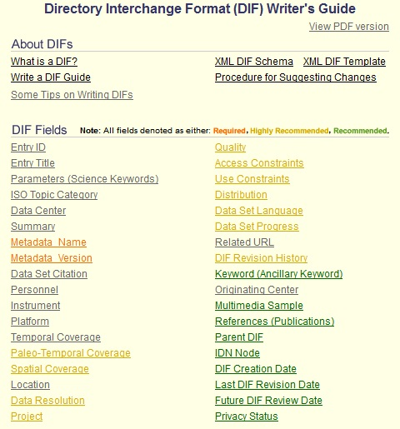
DIF Metadata Standard

Slide 13
Drought Classification
Rao Govindaraju

Slide 14
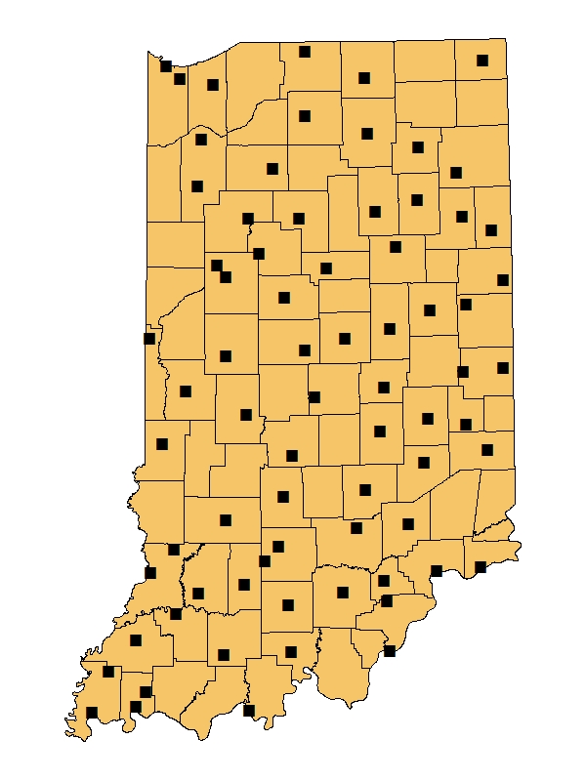
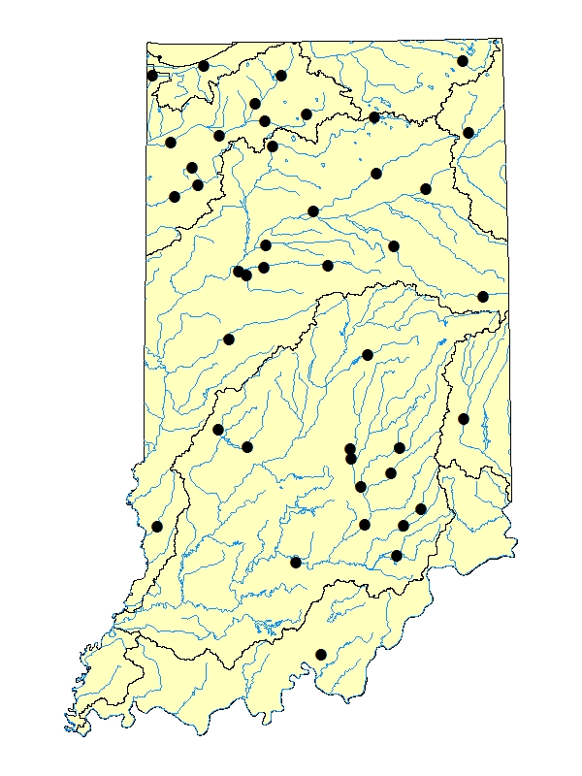
Sources and Study Areas
Precipitation: NCDC daily precipitation dataset; 73 stations with record length greater than 80 years
Streamflow: USGS unregulated daily mean flow; 37 stations with record length greater than 50 years

Slide 15
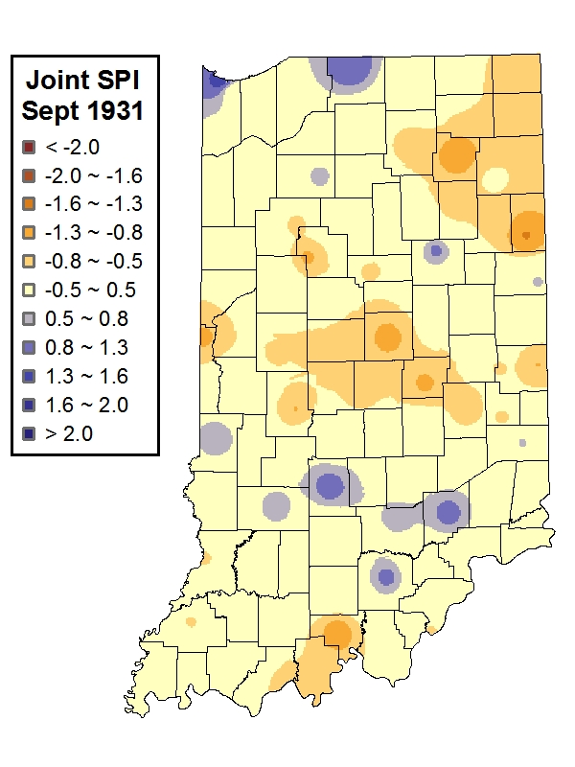
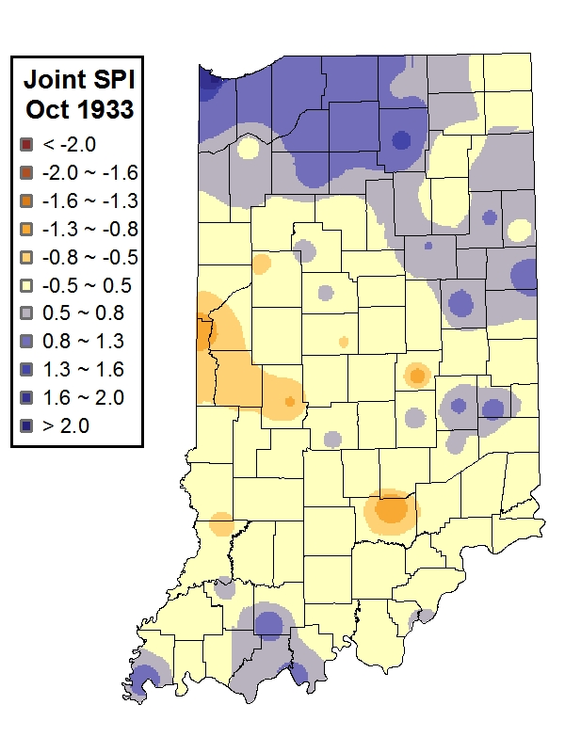
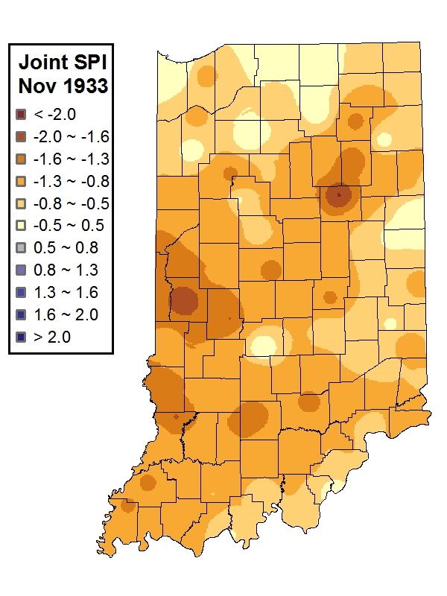
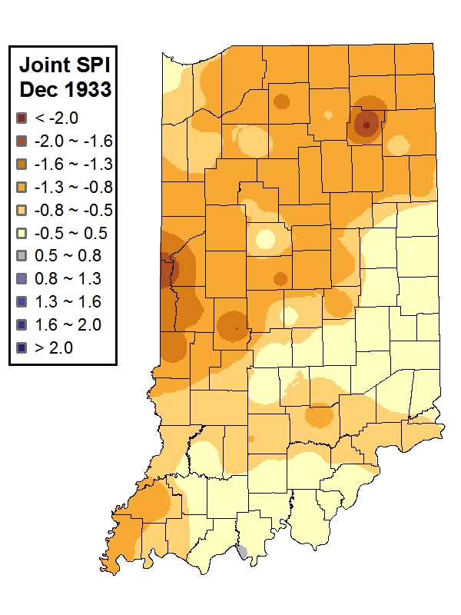
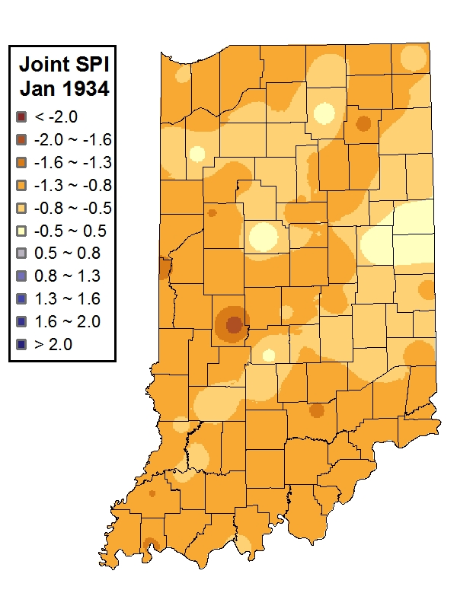
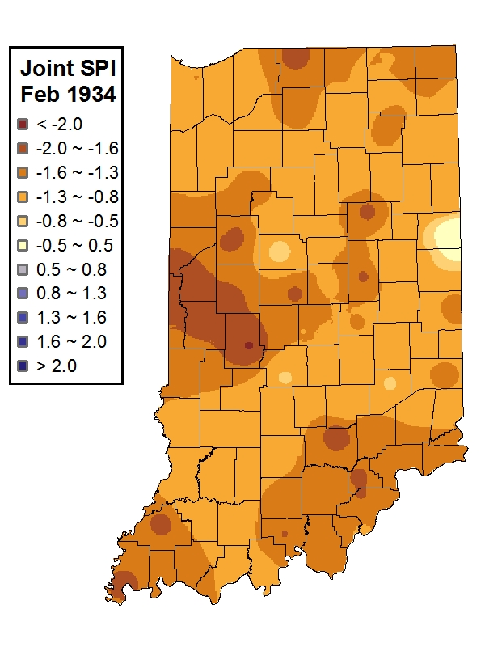
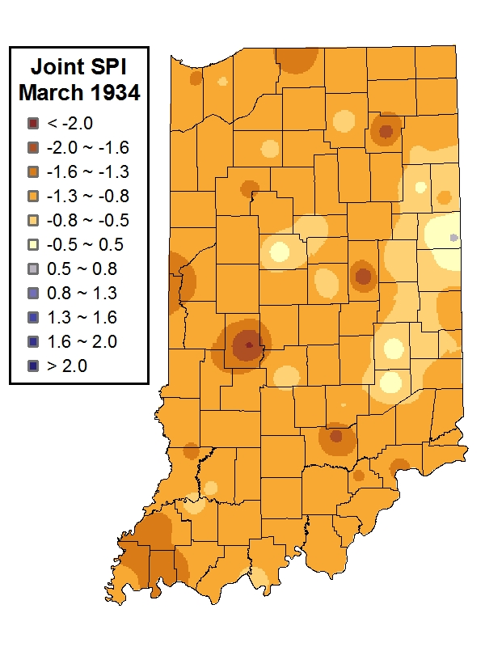
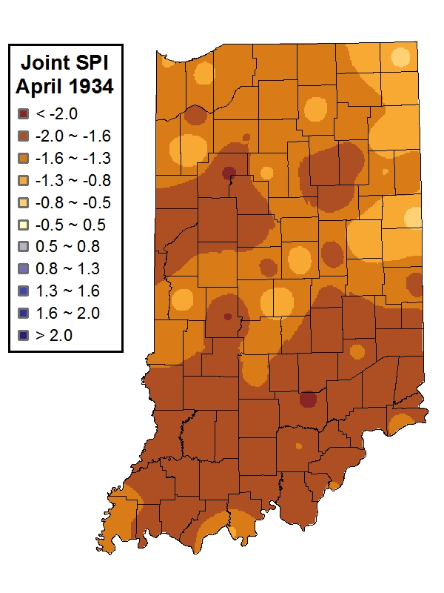
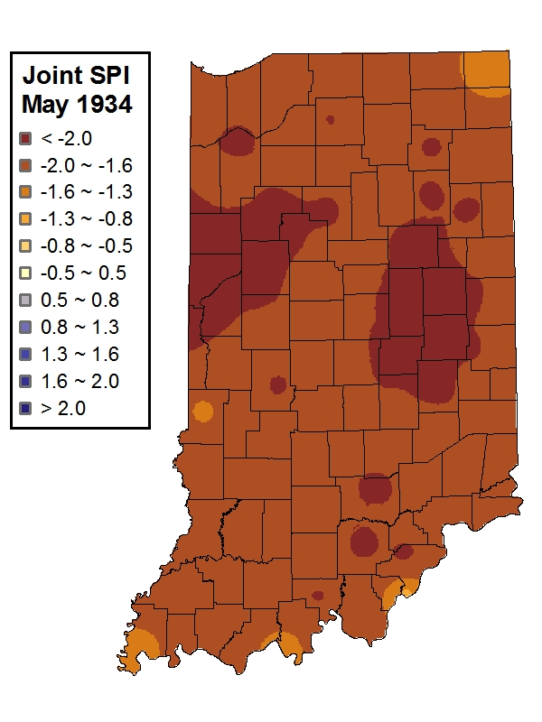
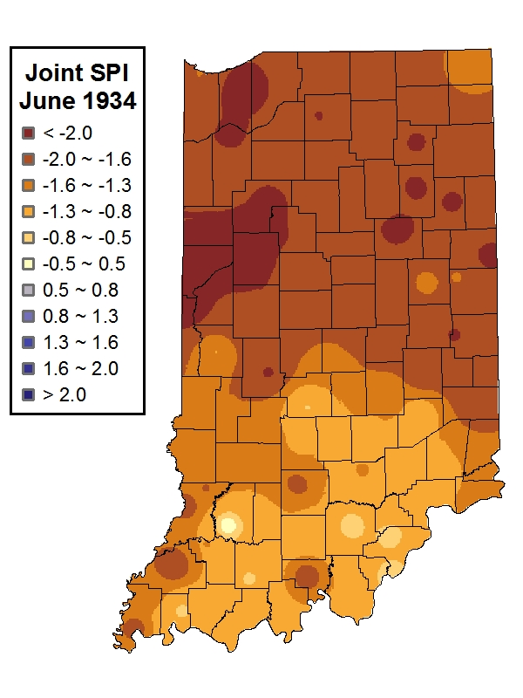
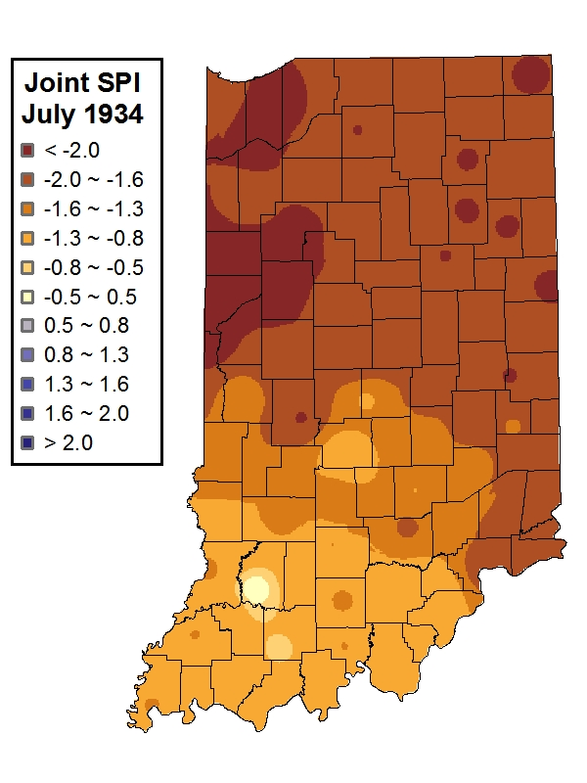
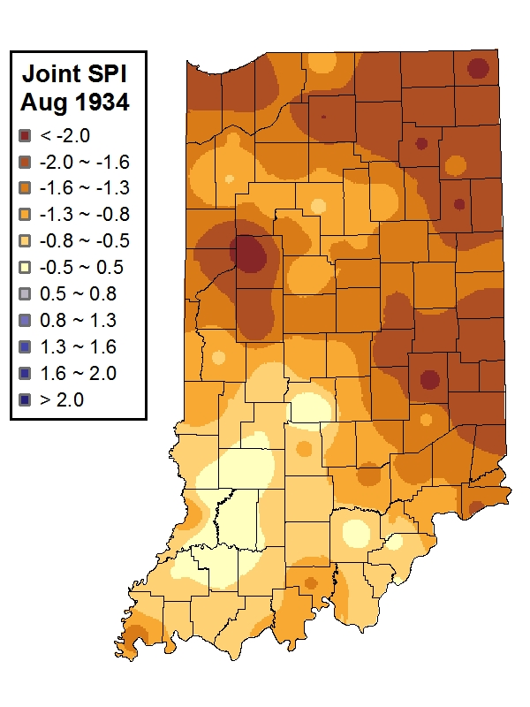
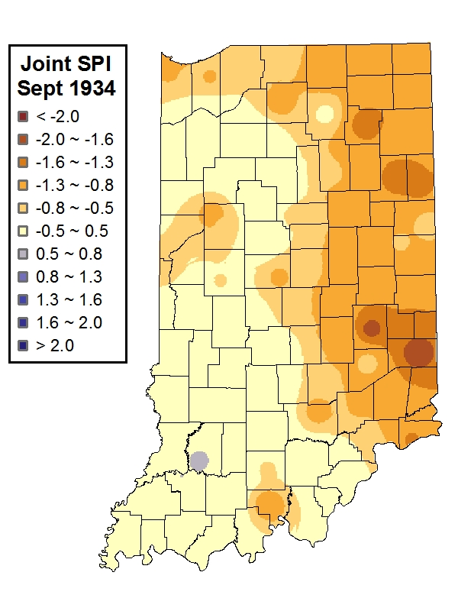
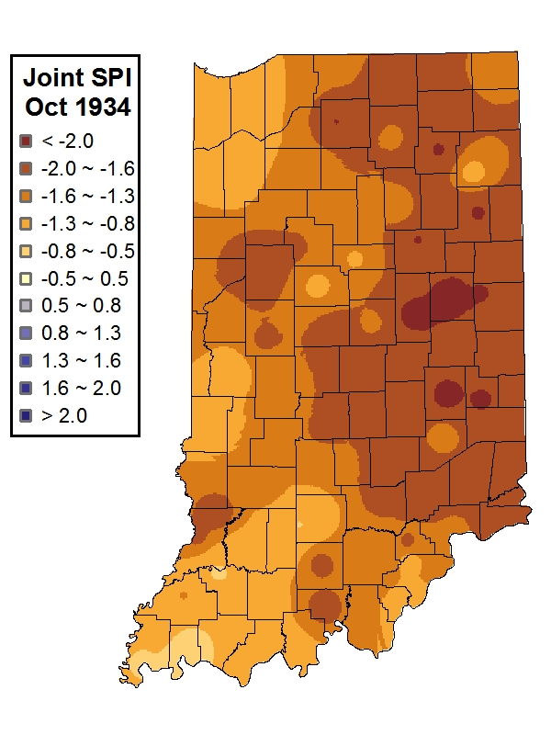
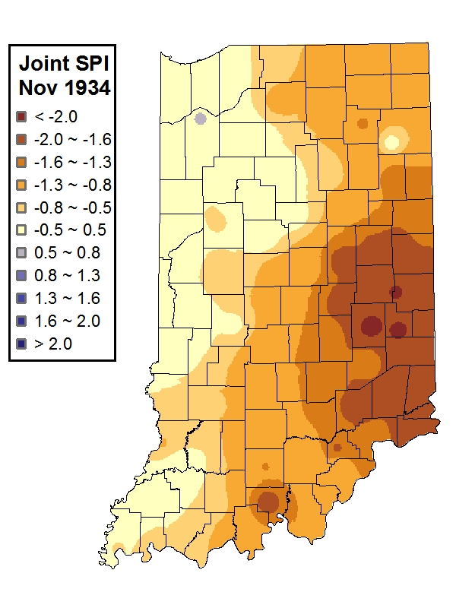
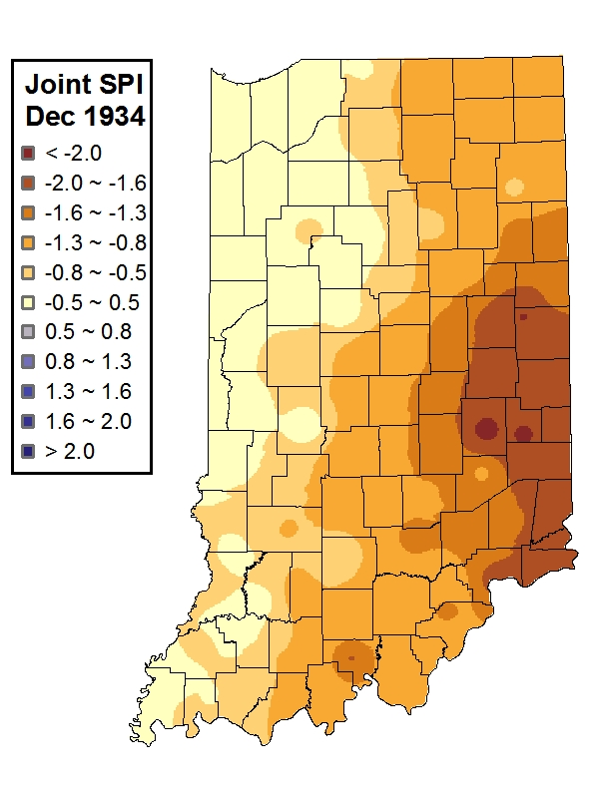
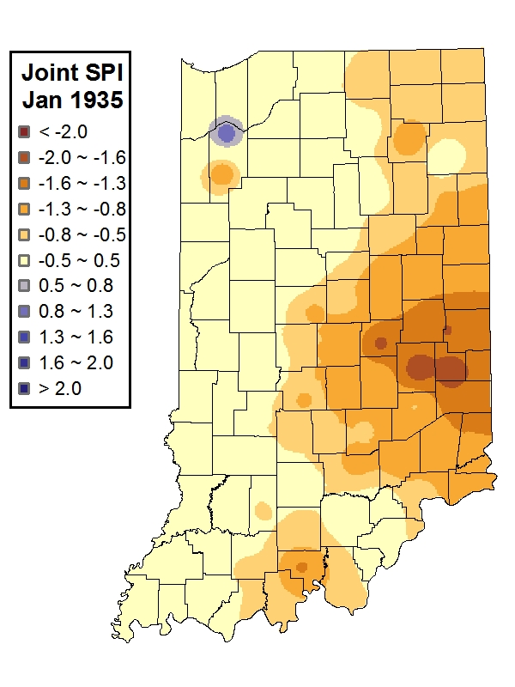
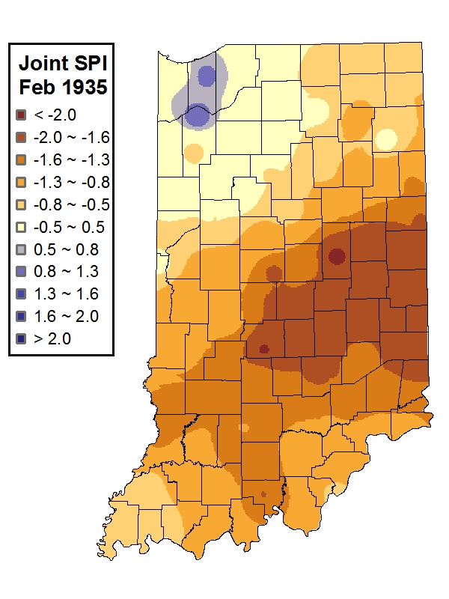
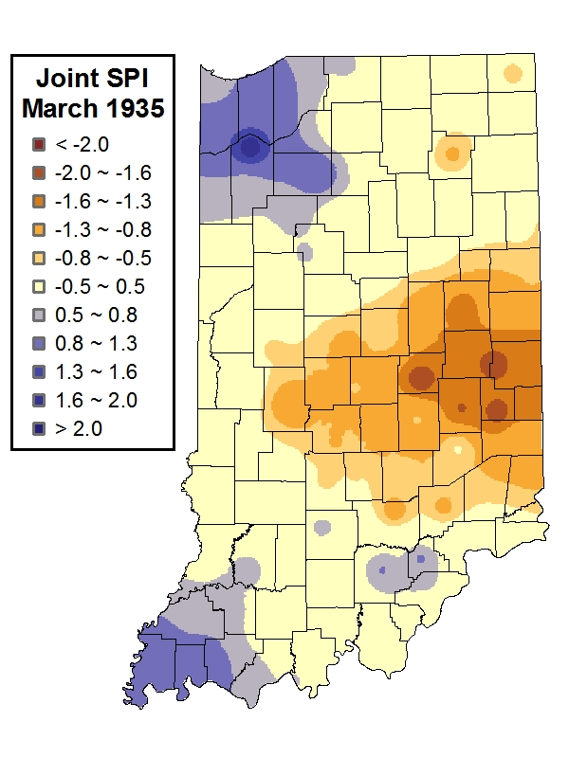
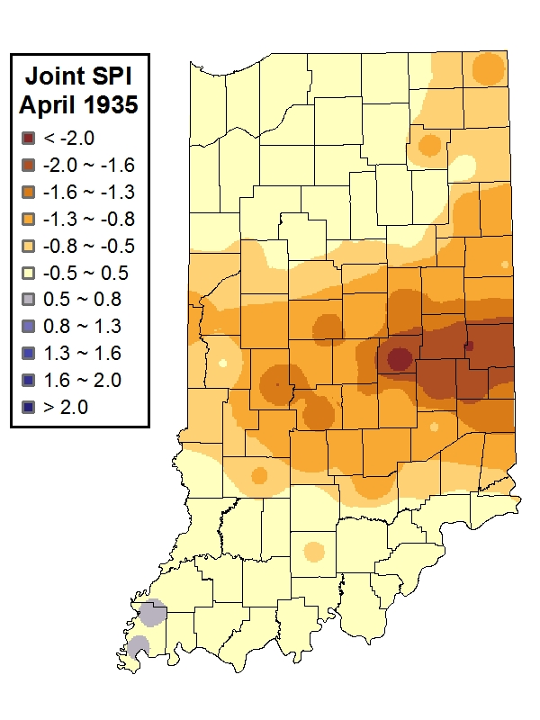
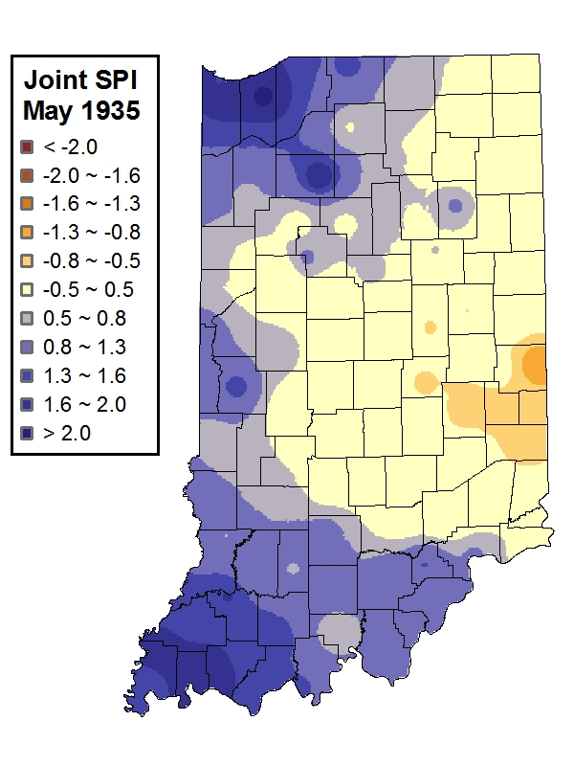
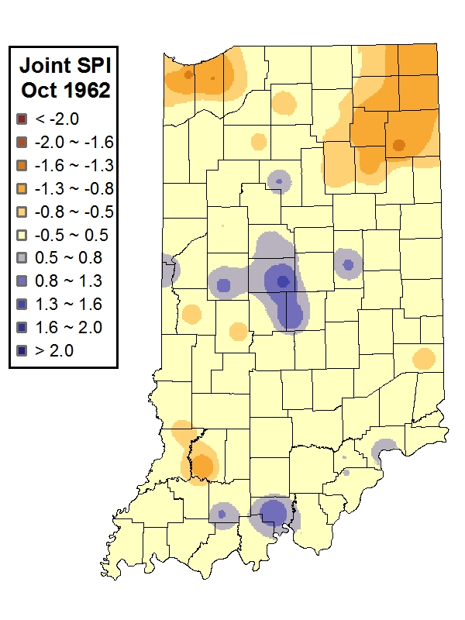
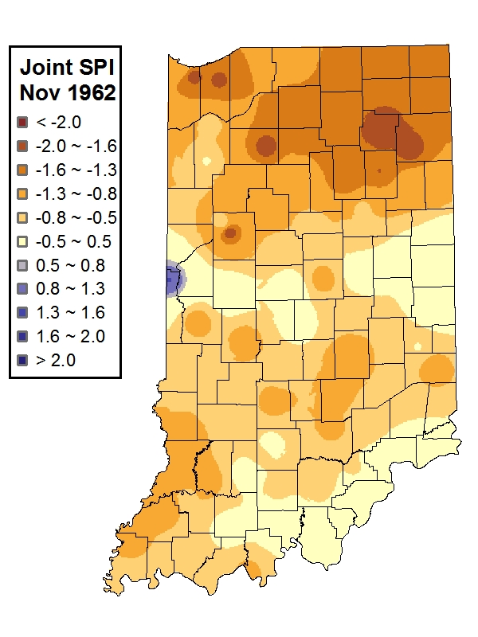
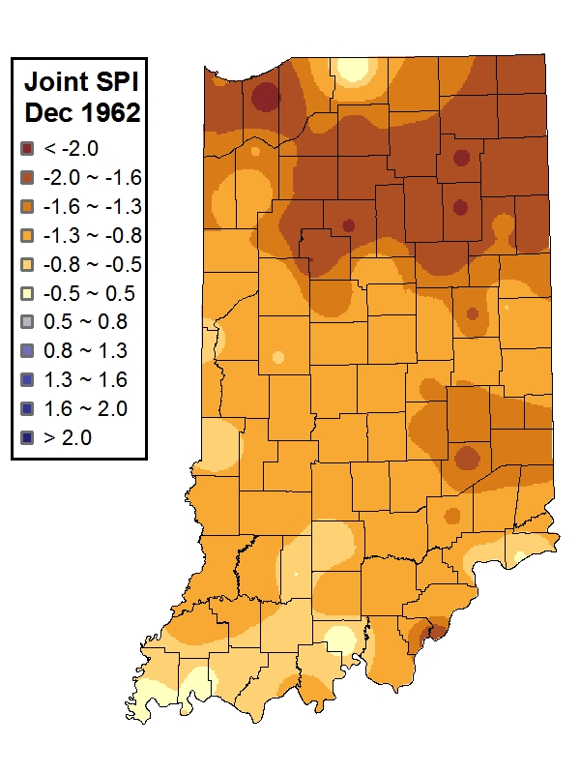
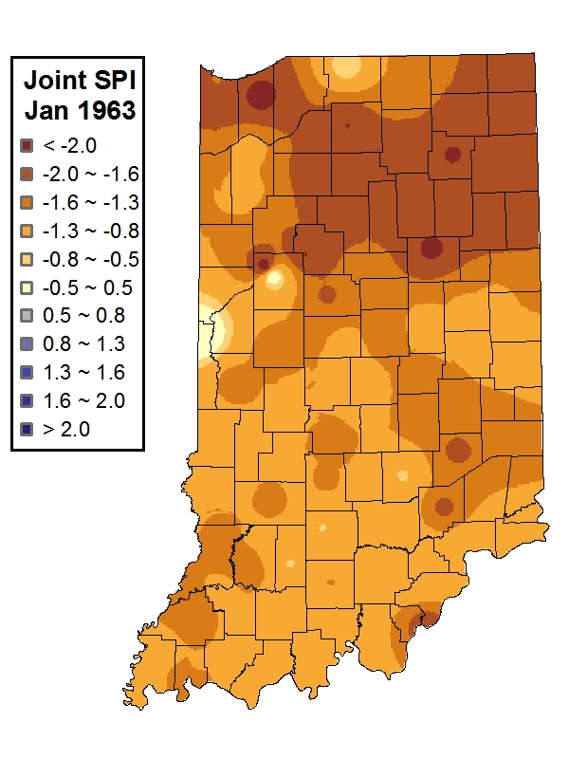
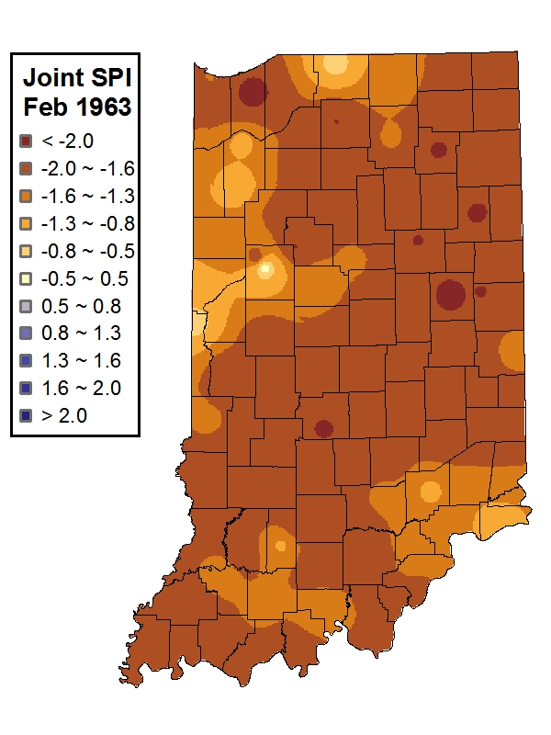
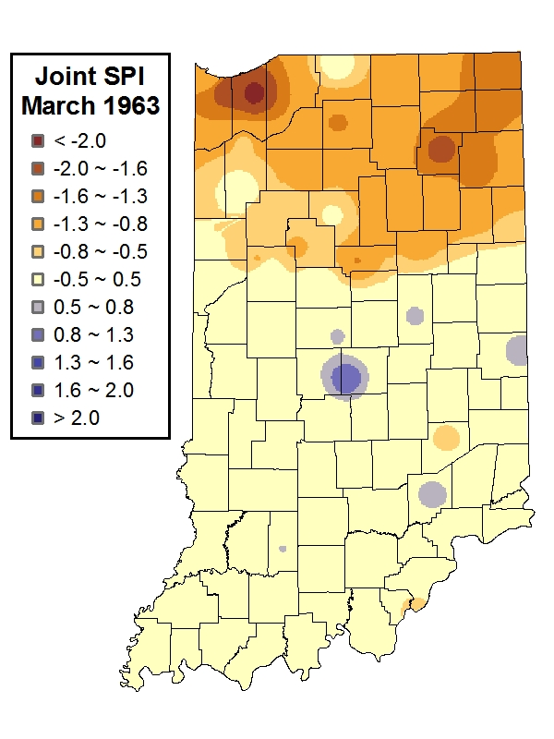






















Joint Deficit Index
Major drought events in Indiana
1930 ~ 1931
1933 ~ 1935
1962 ~ 1964

Slide 16


Water Deficit Projections
Required 1-month precipitation for normalcy, i.e. projected water deficit
Probability of recovering from drought in one month

Slide 17

Probabilistic Drought Classification
1 month HMM-DI vs. SPI at Alpine 2NE, Indiana

Slide 18
Drought implications on river water quality
Indrajeet Chaubey

Slide 19
Comparison of measured data driest (2005) Vs wettest (2003) year

Slide 20
Correlation of nutrients with drought index

Slide 21
Conclusions
        Results indicate that droughts exert an important control on water quality both in terms of concentrations and loads.
        Limited data availability: 11 years of weekly data may be insufficient for hydrological extremes such as droughts.
        Sustainability of new agricultural initiatives, such as biofeedstock production may be constrained by drought events.

Slide 22
DRInet – working with interoperability
Dev Niyogi

Slide 23




Indiana Water Balance
Supply side monitoring: CoCoRaHS
iClimate and NWS Indianapolis have created a Community Collaborative Rain, Hail and Snow (CoCoRaHS) network for Indiana.
Currently over 1500 community observers are provided with a rain gauge and training by iClimate and National Weather Service staff.
Observers monitor and report rainfall values daily.
Data have wide use in drought monitoring, runoff and water quality studies, flooding, and agronomic decisions on a day-to-day basis.

Slide 24



Regional Evapotranspiration
Estimation across PACs
The largest water loss in the state of Indiana comes from evapotranspiration (ET)
Currently, there is no information available as to how much water is being lost.
Obtaining values for ET in the state is crucial tounderstanding the water budget.
ET measurements
Model inputs
Can models be used where ET measurements are not available to extend an ET climatology statewide ?

Slide 25


Indiana Water Balance
Demand side monitoring: ETgage
Johnny/Ken
ETgage water loss data are monitored by automated weather stations and relayed hourly to campus
A comparison between ETgage measurements and ET models at NEPAC in July 2008
ETgages are located at eight PACs and ACRE
Early results show ET models do well in comparison to ET measurements and may be useful to extend an ET climatology from PACs to all of Indiana.
Next: use crop coefficients to apply grass-reference ET to targeted major Indiana crops, such as corn and soybean.

Slide 26



Advising the Indiana Water Shortage Task Force on Drought Declaration
Indiana drought atlas (mapping drought in Indiana and investigating the appropriate drought indices for Indiana) – Recommendations now adopted by Governor’s Water Shortage Task Force for declaring drought in Indiana (Indiana now adopts Standardized precipitation index in place of Palmer drought index)
These results show that the SPI efficiently detects drought emergency and warning and identification of drought severity in its early stages.

Slide 27



High resolution Regional Soil Moisture/ Surface Hydroclimatology
Using Data Assimilation and Photosynthesis based Energy balance models for developing 4km gridded products – assessing water budgets, moisture transport, air quality and meteorological feedback.

Slide 28


Relating Droughts to Cloud Height Changes
Soil moisture is slower to change than atmospheric moisture.
Relating it to cloud potential may give a longer range predictability of cloud & precipitation potential.
Preliminary results show
  Wetter soil tends to produce lower cloud base heights.
  In a wet year, cloud base height not as much a function of soil moisture.
  Very dry soil can have low and high cloud base heights.

Slide 29

Indiana Severe Weather Climatology (1950-2009) with GIS Analysis
Tornado Reports, Convective Wind Reports, Hail Reports (3/4 inch and 1 inch diameter), and Extreme Rainfall Events.
Distribution analysis on yearly, monthly, and hourly storm report data. Distribution analysis on yearly, monthly, and seasonal storm “day” data.
Density analysis of storm report data using ArcGIS with comparison of report distribution to elevation and landcover.
30-year climatology.

Slide 30


How Indianapolis is affecting regional rainfall and thunderstorms?
Ming
a). Indianapolis NWS base reflectivity valid 0033 UTC June 14. b). 15.7o tilt valid 0033 UTC June 14.
Thunderstorms are intensified and lead to heavier rains after passing over Indianapolis region.
Important from city planning and green zone/ agricultural planning

Slide 31
Visualization-based Decision Tools
Daniel Aliaga

Slide 32

Urban Weather Modeling
The local weather in a city is significantly affected by materials and geometry
Use our behavioral-geometrical modeling system to generate the urban morphology
Visualize effect of adopting different urban policies and urban geometries

Slide 33






Urban Weather Modeling
Data
Result
Land use/
land cover
Population
Road Network
Buildings
Terrain

Slide 34




Urban Weather Modeling
Modify land use (e.g., application of greening policy)
New fully instantiated city model is produced

Slide 35






Example Changes in Local Weather
Temperature
Rainfall
Humidity
-1°C
0°C
+1°C
-20mm
0
+20mm
-5%
0
+5%

Slide 36
Future Directions
Drought characterization
  Uncertainty
  Quantification
Environmental impacts
  Air and water quality
Decision tools
  Focus on urban resilience
  Agricultural resilience
Communication

Slide 37
Future Work
Integrate into urban and social planning: how can we change city's and how can be change people's activities in the face of drought?
Provide economic assessment tools, for instance, of $$$ impact of short-term drought and thus identify the benefit of a technology upgrade to deal with less water and benefit of altering crop/land-use based on drought
        Implementing DIF metadata records for all data sets in DRINET; collaborate with other data-driven projects to investigate interoperability and repurposing of data
        Analyze drought implications using water quality attributes simulated by a watershed model (e.g. SWAT).
        Detailed study of water quality data to understand drought indicators using probabilistic approaches.
        Sustainability of biofuel production impacted by climate variability and change.

Slide 38
Panel Questions
Are we missing any data sources that can be added to drought monitoring that we are currently either not collecting well or are unable to incorporate into the analysis due to monitoring, mobilizing, calibration or lending issues? What are the modes and approaches to engage these datasets? Are there issues of ground survey to assess calibration, validity etc? Are there any other hindrances?
Can drought assessment handle uncertainty, for example, as indicated in DRInet? How can it be addressed within drought indices and decision making? What are useful ways for this information to be conveyed to end users?
If uncertainty is accepted in drought classification, what is the best mechanism for engaging this information into impact assessment or vulnerability calculations?
What are vulnerabilities in the urban areas, and how are they different from ag applications?
Can urban areas (i.e., dense locations where people live and use water) be improved/altered so that their water consumption is less?
Is this a priority or is it more of a concern for agriculture?
When there is drought, there is less water in general, so how much/directly does this affect urban areas?
Should we address this as part of same drought monitor, with a special concern section for urban areas?
What longer term resilience options are there for droughts?
Where is drought in education?

