Slide 1
Visualization by Outsourcing The 9/11 Simulations: A Cyber Infrastructure Case Study
Christoph Hoffmann
Purdue University West Lafayette, IN 47907 USA
Notes:
The case study is about our 9/11 simulations

Slide 2
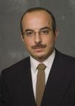
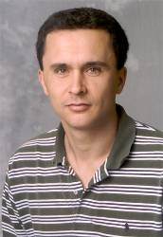
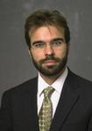
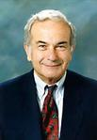
Acknowledgements
Ayhan Irfanoglu, CE Voicu Popescu, CS Santiago Pujol, CE Mete A. Sozen, CE
Oscar Ardila-Giraldo, CE Ingo Brachmann, CE Tyler Krahn, CE Paul Rosen, CS
NSF ITR DSC-0325227 DOE NWICG award
Notes:
My collaborators. It was a pleasure to work with them all.

Slide 3
Central Issue
When federating major software components (programming in the large), there is often a mismatch between representations
The CS team worked out how to federate FEA codes with Graphics and Visualization systems and overcome the mismatches.
Notes:
This is a general problem. We solved it in the 9/11 context.

Slide 4
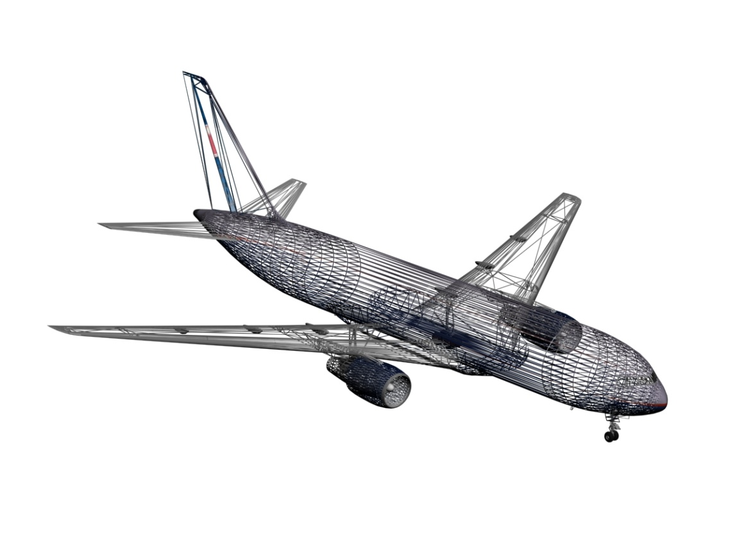
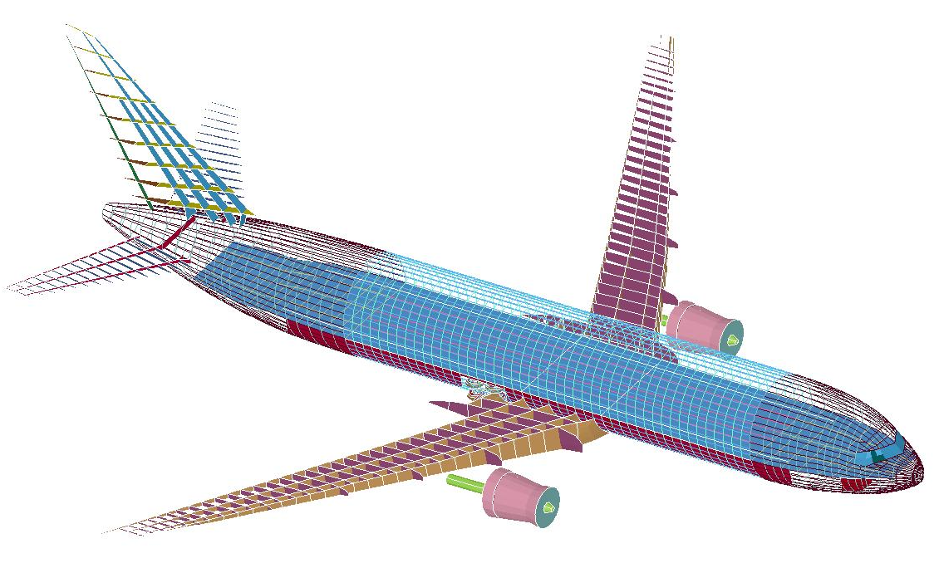
Example of Mismatch: Plane Models
Notes:
Left is a graphics model. It is wholly unsuitable to FEA and needs to be converted. The result is on the right. Conversion is only partially automatic

Slide 5
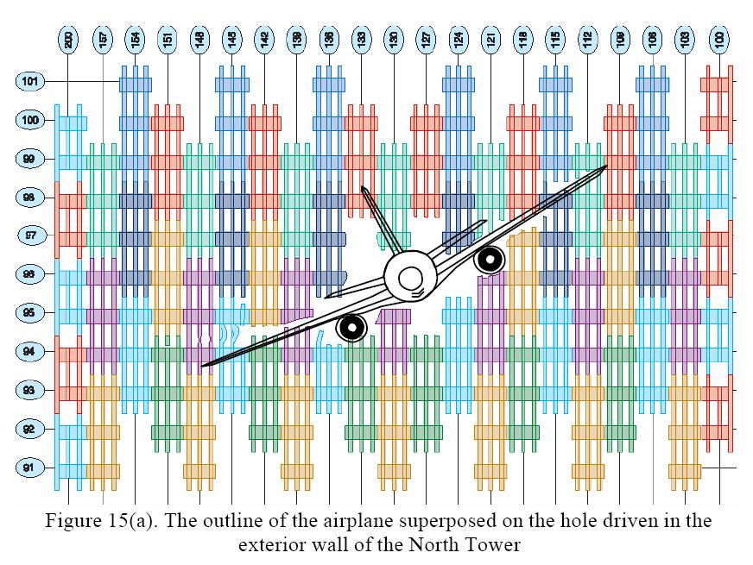
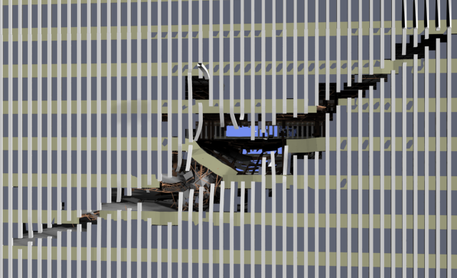
Simulation Results
Comparison between simulated and actual damage
Notes:
An uncanny match between the FEA simulation (left), a contemporary photograph (right bottom), and FEMA’s schematic (right top)

Slide 6
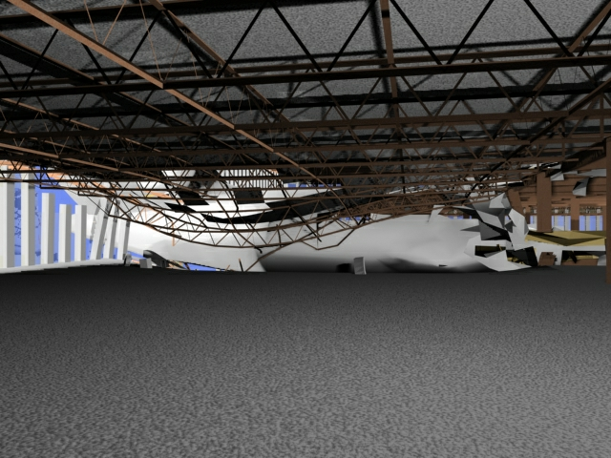
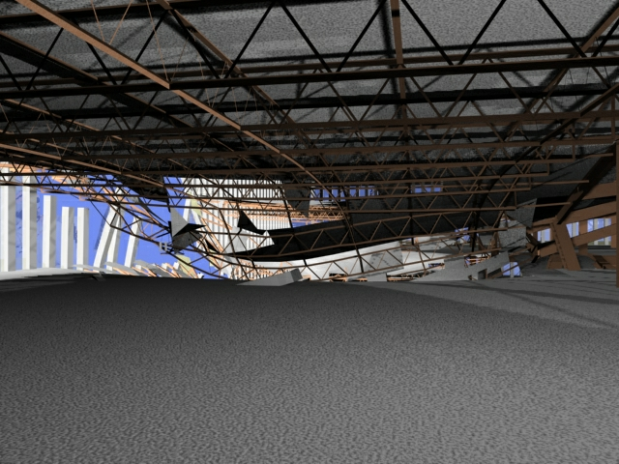
Visualizations
Oblique view
(inside, towards core)
Notes:
An example of the high quality visualization that is possible.

Slide 7
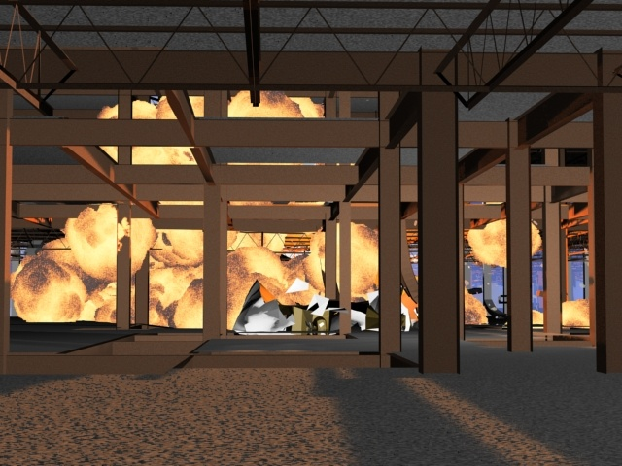
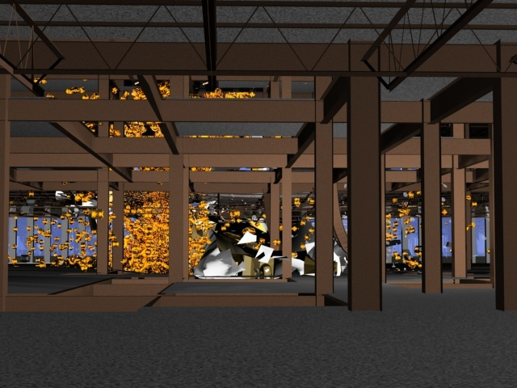
Fire visualization (left) controlled by SPH fuel elements (right)
Notes:
Special effects: fire cannot be simulated in detail, it has to be plausibly created.

Slide 8
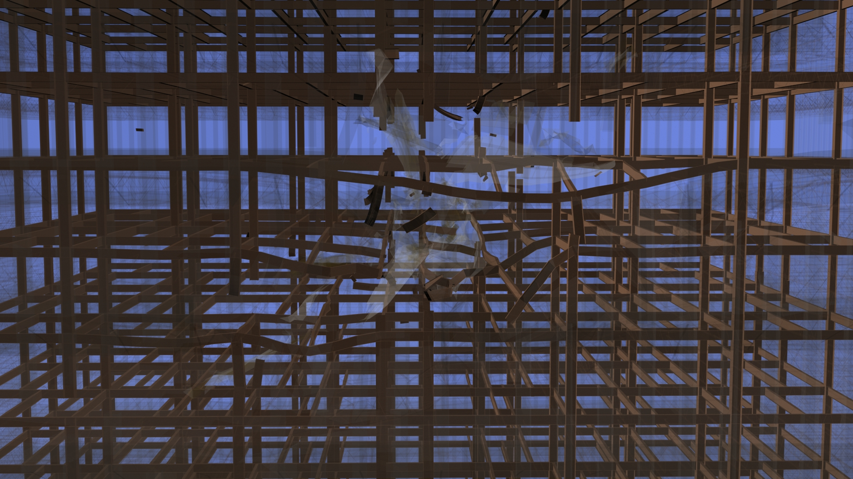
Profiles restored
Notes:
Special problem 1: FEA representation may not have the geometry of the beams, only a line and the beam physics

Slide 9
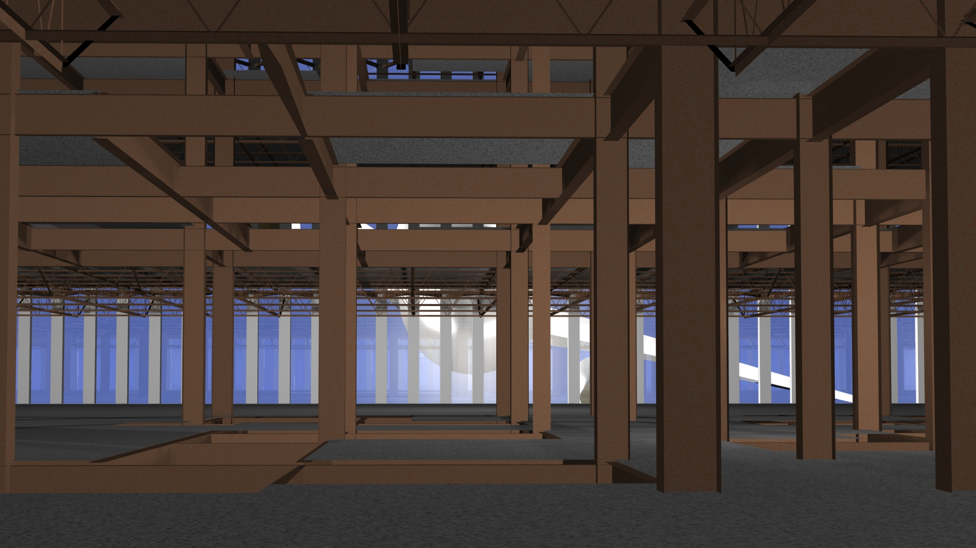
Joints reconstructed
Notes:
Special problem 2: The geometry of beam connections may not be modeled by the FEA representation.

Slide 10
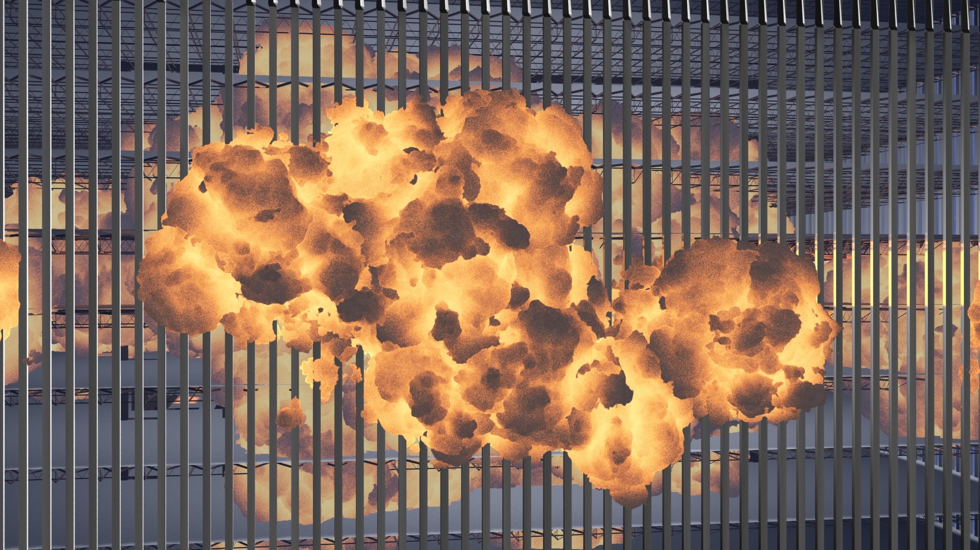
Special Effects created
Notes:
Special problem 3: some things cannot be reproduced exactly, and the fire ball is one of them. So it has to be illustrated with a plausible appearance guided by the liquid dispersion that the FEA analysis modeled.

Slide 11
Links:
www.cs.purdue.edu/homes/cmh/simulation/
www…/simulation/wtc1.mov (133 MB)
Notes:
Here are links where people can find both the movie as welll as information about our project, time line, etc.

