Slide 1
Big Data and Artificial Intelligence as a Tool for Global Sustainability
Vipin Kumar
University of Minnesota
kumar001@umn.edu
www.cs.umn.edu/~kumar

Slide 2
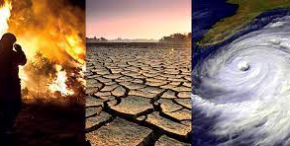
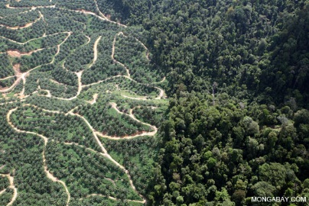
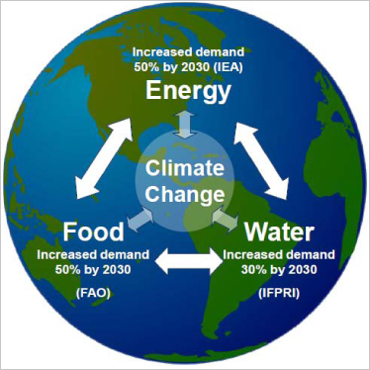
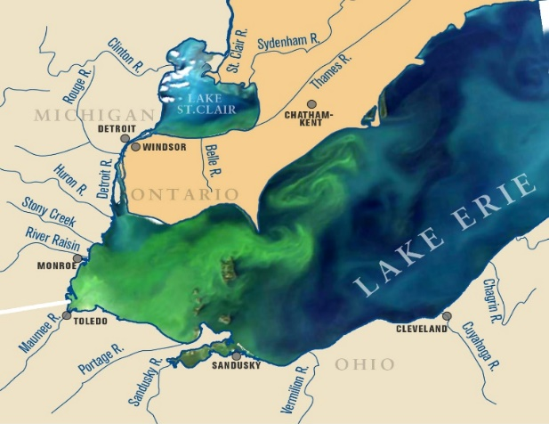
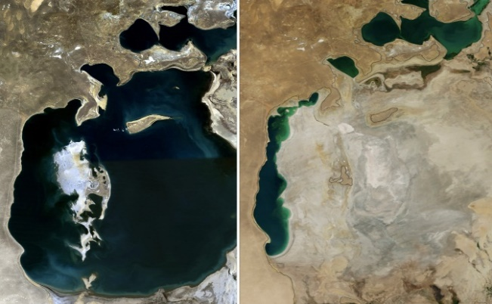
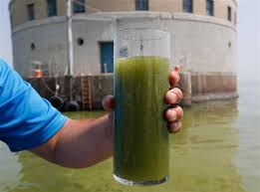
Environmental Grand Challenges of the 21st Century
IPCC Report warns of ‘irreversible’ impacts of global warming 2/28/2022
How to Feed the World Without destroying the Planet?
Cool Green Science by Nature, July 7, 2017
Increasing frequency of natural disasters
Oil Palm Plantations in Indonesia
Water quality impacted by Agriculture
Freshwater resources under stress
Harmful Algal Bloom in Lake Erie
Aral Sea in 1989
Aral Sea in 2014

Slide 3
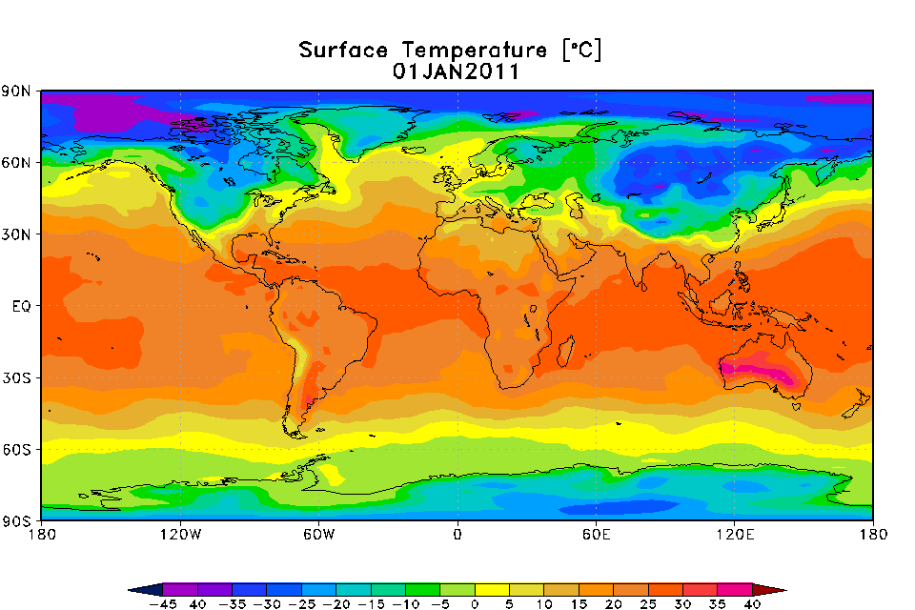
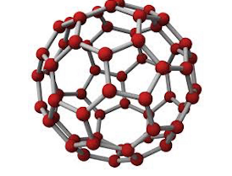
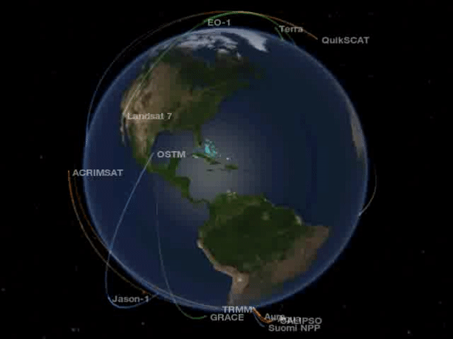
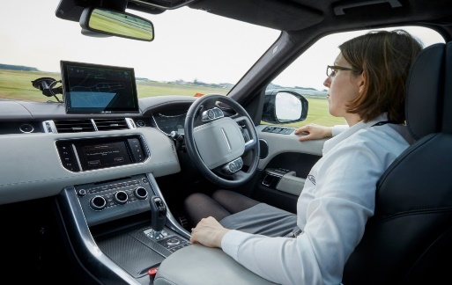
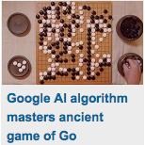
Golden Age of Data Science
Hugely successful in commercial applications:

Slide 4
Golden Age of Data Science
Challenges: High degree of spatial and temporal heterogeneity make it hard for ML to generalize to out-of-sample scenarios
Solution: Knowledge-Guided Machine Learning (KGML) combines the power of scientific knowledge encoded in process-based models and state of the art ML
Hugely successful in commercial applications:

Slide 5
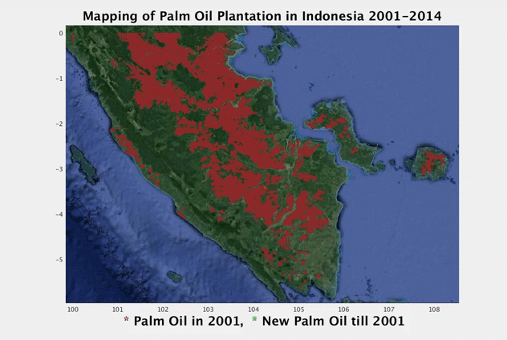
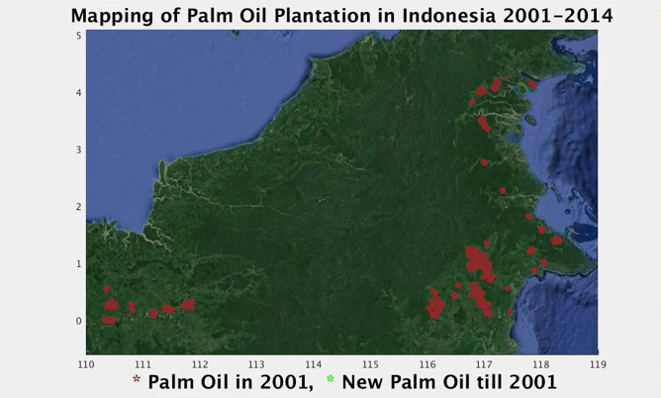
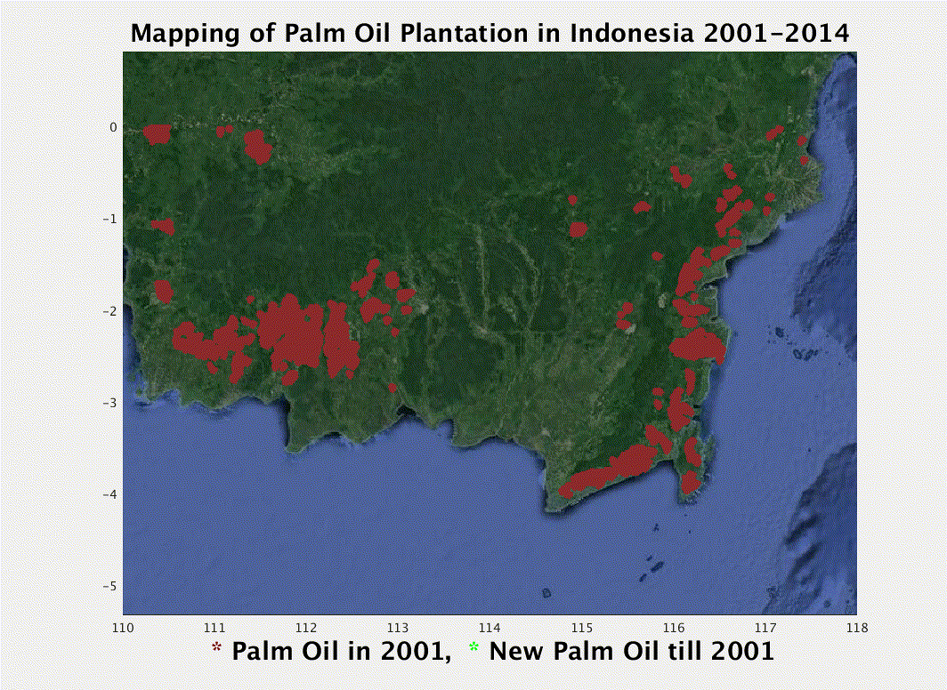
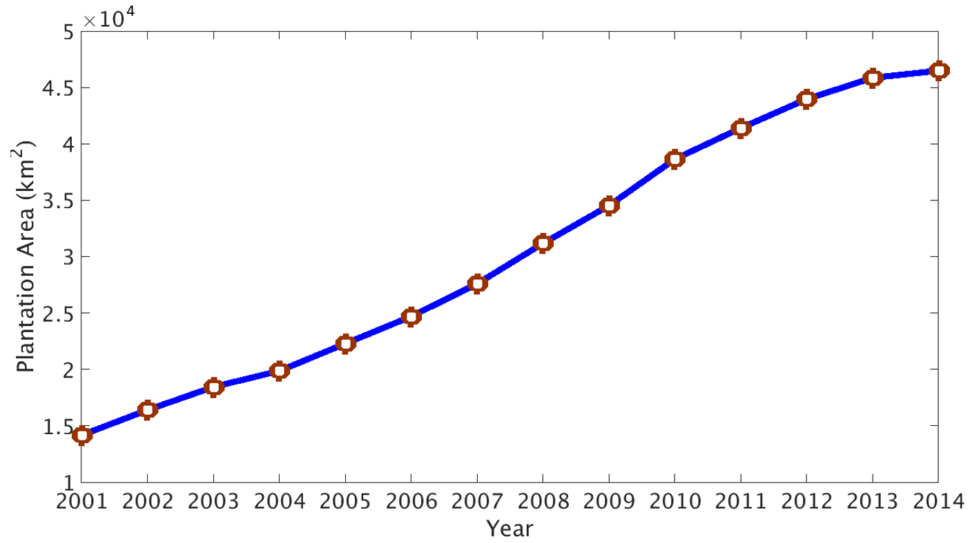
KGML Generated Maps of Plantation Dynamics
h29v08
h28v09
Annual growth rate $≈$ 9.57%
h29v09

Slide 6
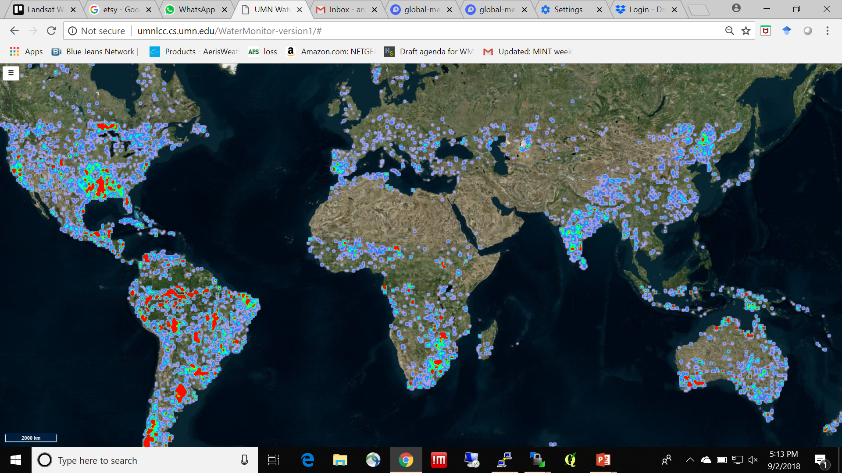
ReaLSAT: Reservoir and Lake Surface Area Time-series Database http://umnlcc.cs.umn.edu/realsat/
Monthly scale surface area dynamics from 1984 to 2015 at 30m resolution
using JRC-Google product as input label source ¹
Over 700k water bodies of size greater than 0.1 sq. kms below 50 degrees North
1. Pekel et. al, High-resolution mapping of global surface water and its long-term changes. Nature 540, 418-422 (2016). (doi:10.1038/nature20584)
Size | Count
between 0.1 and 1 km² | 645815
between 1 and 10 km² | 86363
between 10 and 100 km² | 10606
between 100 and 1,000 km² | 5044
greater than 1,000 km² | 162
Total | 747990
Note: The heat map is incomplete, as it represents only the subset of the database processed until July 2019 (345k water bodies)
Notes:
The Joint Research Centre (JRC) is the European Commission's science and knowledge service which employs scientists to carry out research in order to provide independent scientific advice and support to EU policy.
Currently, we have processed 66 K lakes.
Change the name of the website
Redo the tutorial

Slide 7
ReaLSAT: Resrvoir and Lake Surface Area Timeseries Database http://umnlcc.cs.umn.edu/realsat/
Monthly scale dynamics from 1984 to 2015 at 30m resolution
using JRC-Google product as input label source ¹
Over 700k water bodies of size greater than 0.1 sq. kms.
Provides dynamics of water bodies
Identifies new lakes and reservoirs
Enables calibration of flood models
1. Pekel et. al, High-resolution mapping of global surface water and its long-term changes. Nature 540, 418-422 (2016). (doi:10.1038/nature20584)
Size | Count
between 0.1 and 1 km² | 645815
between 1 and 10 km² | 86363
between 10 and 100 km² | 10606
between 100 and 1,000 km² | 5044
greater than 1,000 km² | 162
Total | 747990
Notes:
The Joint Research Centre (JRC) is the European Commission's science and knowledge service which employs scientists to carry out research in order to provide independent scientific advice and support to EU policy.
Currently, we have processed 66 K lakes.
Change the name of the website
Redo the tutorial

Slide 8
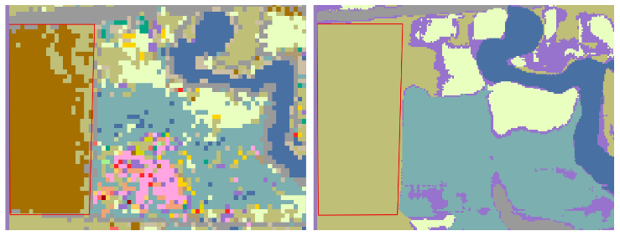
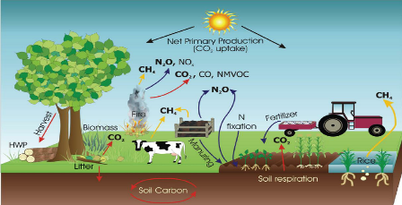
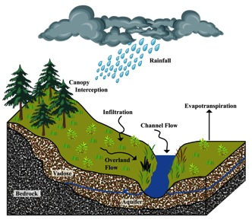
ML for Environmental Sciences: Additional Research Highlights
USDA Cropland Data Layer CDL
CALCROP21
Spatio-Temporal Semantic Segmentation
Mapping Crops at Scale
Attention augmented deep learning algorithm jointly exploits the spatial and temporal nature of satellite data.
Created a 10m resolution crop map for the entire California Crop Belt that is more accurate than the 30m resolution CDL used as labels for training
Knowledge Guided Machine Learning (KGML)
Modeling Lake Water Quality
Combining Physics and Data Science models to overcome complementary weaknesses
Hybrid models are significantly more robust and are of higher quality than either pure physics or pure data models
Self-supervised KGML
Inverse Modelling in Hydrology
Deep learning based inverse framework for estimating features given driver-response data
Proposed framework reduces uncertainty in the catchment characteristics of hydrological basins.
KGML for Agro-Ecosystem Sustainability
Modelling GHG emission in Agriculture
Scientific Knowledge guided process based models
KGML-ag provides much more accurate modeling of GHG emissions relative to state of the art process based models

Slide 9
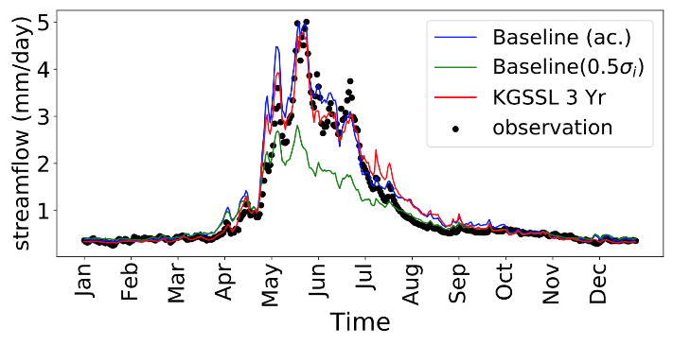
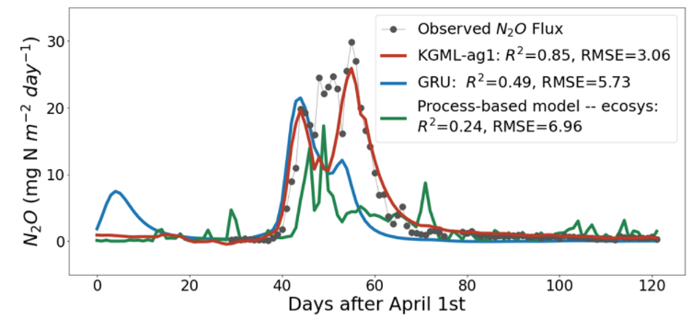
ML for Environmental Sciences: Additional Research Highlights
USDA Cropland Data Layer CDL
CALCROP21
Spatio-Temporal Semantic Segmentation
Mapping Crops at Scale
Attention augmented deep learning algorithm jointly exploits the spatial and temporal nature of satellite data.
Created a 10m resolution crop map for the entire California Crop Belt that is more accurate than the 30m resolution CDL used as labels for training
Knowledge Guided Machine Learning (KGML)
Modeling Lake Water Quality
Combining Physics and Data Science models to overcome complementary weaknesses
Hybrid models are significantly more robust and are of higher quality than either pure physics or pure data models
Self-supervised KGML
Inverse Modelling in Hydrology
Deep learning based inverse framework for estimating features given driver-response data
Proposed framework reduces uncertainty in the catchment characteristics of hydrological basins.
KGML for Agro-Ecosystem Sustainability
Modelling GHG emission in Agriculture
Scientific Knowledge guided process based models
KGML-ag provides much more accurate modeling of GHG emissions relative to state of the art process based models

Slide 10
Concluding Remarks
Big data and machine learnng offers great opportunity to increase our understanding of the Earth’s climate and environment
Addressing challenges unique to environmental problems require methodological advances in machine learning
Novel approaches are needed that can guide the process of knowledge discovery in scientific applications
“Knowledge-Guided Machine Learning (KGML)”
Methods have applicability across diverse domains:
Ecosystem management
Epidemiology
Geospatial Intelligence
Neuroscience

Slide 11
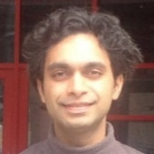
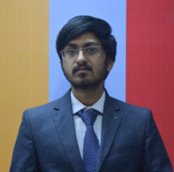
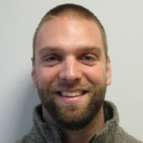
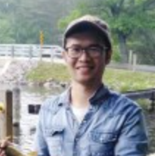
Team Members Acknowledgements
NSF: 1029711, Expeditions in Computing: Collaborative Research: Understanding Climate Change: A Data Driven Approach; 1739191, INFEWS/T3: Innovations for Sustainable Food, Energy, And Water Supplies In Intensively Cultivated Regions: Integrating Technologies, Data, And Human Behavior; 1838159, BIGDATA:F: Advancing Deep Learning to Monitor Global Change; 1943721, HDR Collaborative Research: Knowledge Guided Machine Learning: A Framework for Accelerating Scientific Discovery;201962, STC: Learning the Earth with AI and Physics
NASA: NNX16AB21G, Scalable Analysis of Earth System Data Using Parallelized Graph-Based Approaches; NNX12AP37G, Integrating Parallel and Distributed Data Mining Algorithms into the NASA Earth Exchange (NEX); Planetary Skin Institute: Global Land Use Change; USGS: Process guided machine learning for water temperature prediction; ARPA-E: SMARTFARM Phase 2
Saurabh Agrawal
Gowtham Atluri
Shyam Boriah
Ivan Brugere
Xi Chen
Kelly Cutler
James Faghmous
Ashish Garg
Rahul Ghosh
Xiaowei Jia
Collaborators
UMN: Arindam Banerjee, Snigdhansu Chatterjee, Zhenong Jin, Stefan Liess, John Nieber, Phil Pardey, Shashi Shekhar
Anuj Karpatne
Jaya Kawale
Ankush Khandelwal
Arjun Kumar
Lydia Manikonda
NCSU: Nagiza Samatova, Fredrick Semazzi
Northeastern University: Auroop Ganguly
North Carolina A&T: Abdollah Homaifar
NASA Ames: Ramakrishna Nemani, Nikunj Oza
Penn State: Christopher Duffy
Varun Mithal
Guruprasad Nayak
Praveen
Ravirathinam
Arvind
Renganathan
Somya Sharma
UCLA: Dennis Lettenmaier, Miriam Marlier
U of Wisconsin: Paul Hanson, Hilary Dugan
USGS: Alison Appling, Jordan Read, Jeff Stadler, Jacob Zwartz
Michael Steinbach
Kshitij Tayal
Karsten
Steinhaueser
Jared Willard
Shaoming Xu

